Slide 1


HTML Form

Slide 2
FORMS
HTML5 Web forms are those sections on the Web page that contain special elements called as controls.
The controls, such as check boxes, radio buttons, and text boxes provide a visual interface to the user to interact with them.
In HTML5, creation of form is made easier for Web developers by standardizing them with rich form controls.
It also provides client-side validations that are now handled natively by the browsers.

Slide 3
<form>
<input type=“text” />
….
</form>
Syntax
<input type=“type” placeholder=“Message here ” value=“value of the input type” required/>
Radio Button
Male <input type=“radio” name=“r1” />
Female <input type=“radio” name=“r1” />
Checkbox
HTML <input type=“checkbox” name=“r1” />
CSS <input type=“checkbox” name=“r2” />

Slide 4
File
<input type=“file” />
<label for=“html”> </label>
<textarea rows="4" cols="10"> </textarea>

Slide 5
Input types in Form
^{Type}
^{text}
^{email}
^{search}
^{url}
^{tel}
^{number}
^{radio}
^{Type}
^{checkbox}
^{Date}
^{range}
^{Week}
^{month}
^{time}
^{datetime}
^{color}
^{Type}
^{textarea}
^{Submit}
^{button}

Slide 6
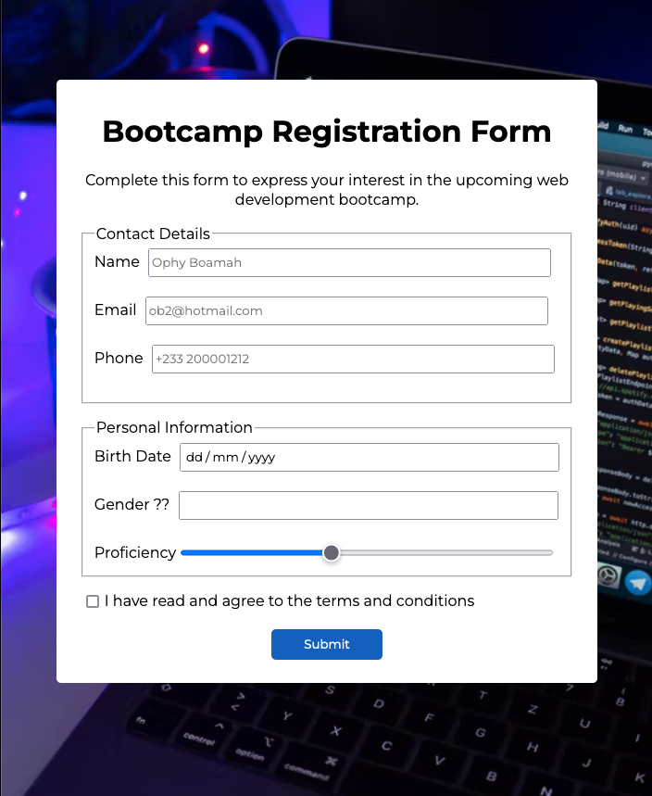
Attributes
^{Type}
^{placeholder}
^{required}
^{autofocus}

